Slide 1
TOPIC 7:
CONTROL SYSTEMS
LESSON 7-1
CONTROL SYSTEMS

Slide 2
AGENDA
Control Systems
Heating Systems
Taxi Meters
Elevators
Washing Machines
Process Control
Device Drivers
Domestic Robots
GPS Systems
Traffic Lights
Microprocessors
NOTE!
Have a way to take notes available for this lesson

Slide 3
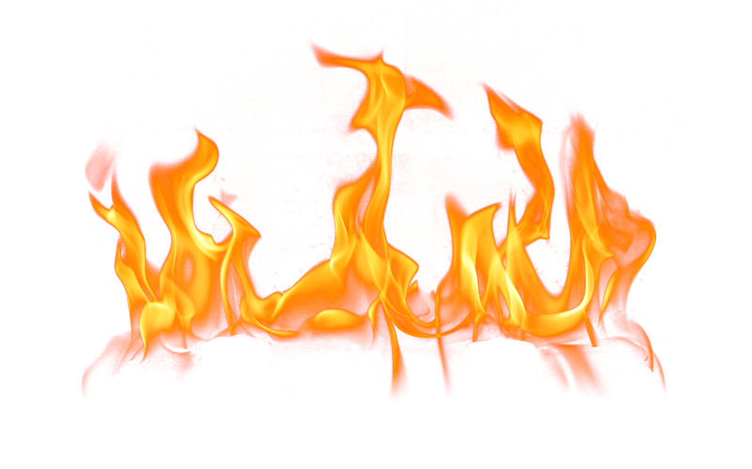
THE WARM UP QUESTION
What data mining technique would be used to find the following patterns in a dataset?
People who buy a toothbrush are very likely to also buy toothpaste
People who buy a car will get an oil change in a few months
Stock prices in the next two months

Slide 4
THE WARM UP ANSWER
Associations
Sequential Patterns
Forecasting

Slide 5
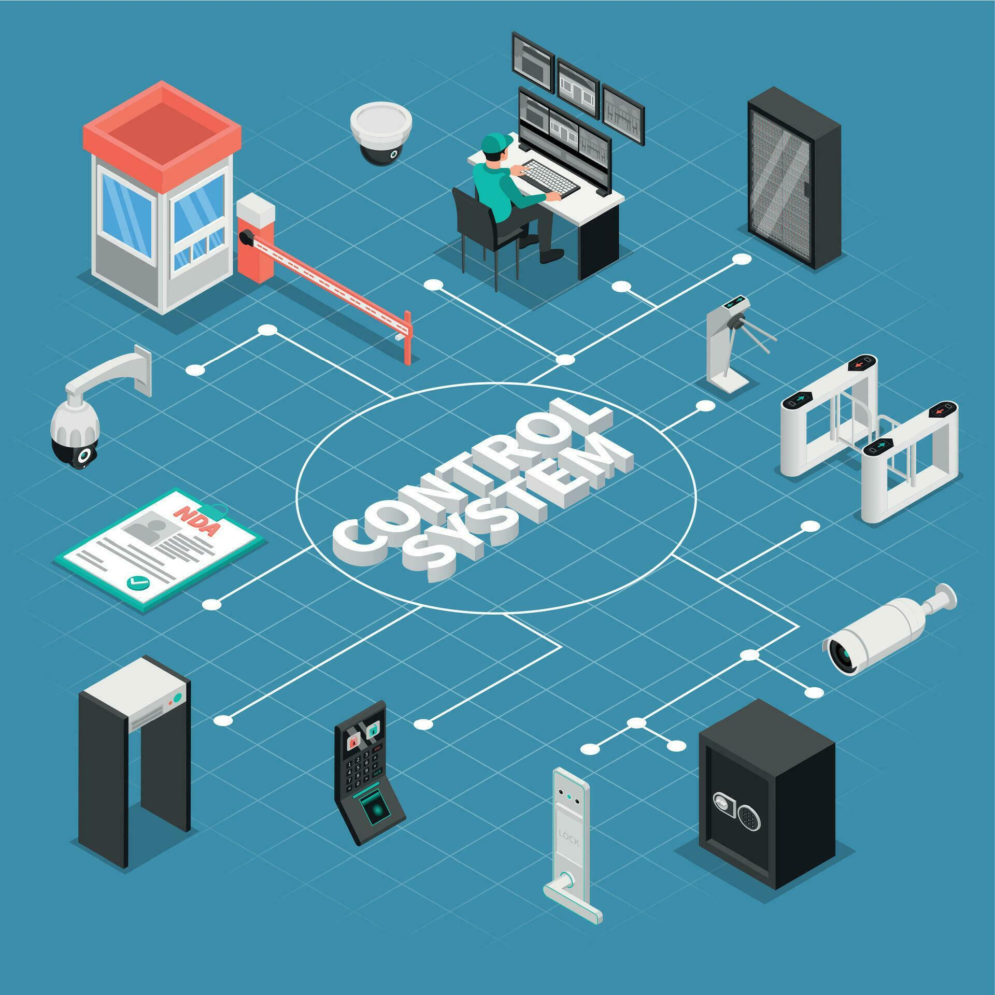
CONTROL SYSTEMS
Control System – one or more devices that guide other devices or systems
Allow for automated completion of tasks
Often include sensors to gain feedback from the environment
Often include motors to control devices appropriately

Slide 6
CONTROL SYSTEMS
Control System Example:
We’ll be looking at some examples of control systems in today’s lesson
Strap in, and be thinking about other types of control systems you might encounter

Slide 7
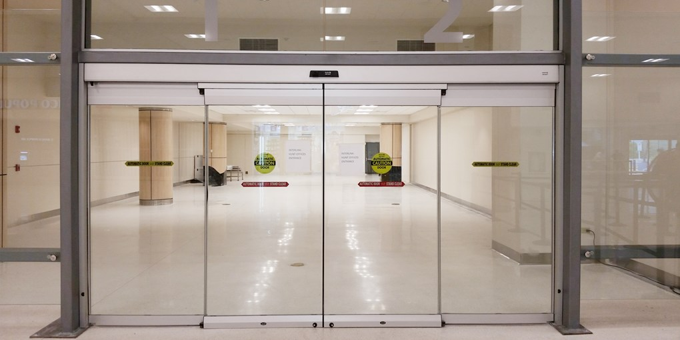
CONTROL SYSTEMS
Automated doors
Found in various places, like supermarkets
Instead of manually opening/closing the doors, a sensor is located at the top of the doors, allowing it to detect motion
Sensors may use infrared or microwave signals that bounce off of objects to detect motion
Sensor sends signal to a microprocessor (computer)
Microprocessor sends signal to actuators that open door
What are the input, process, and output of this system?

Slide 8
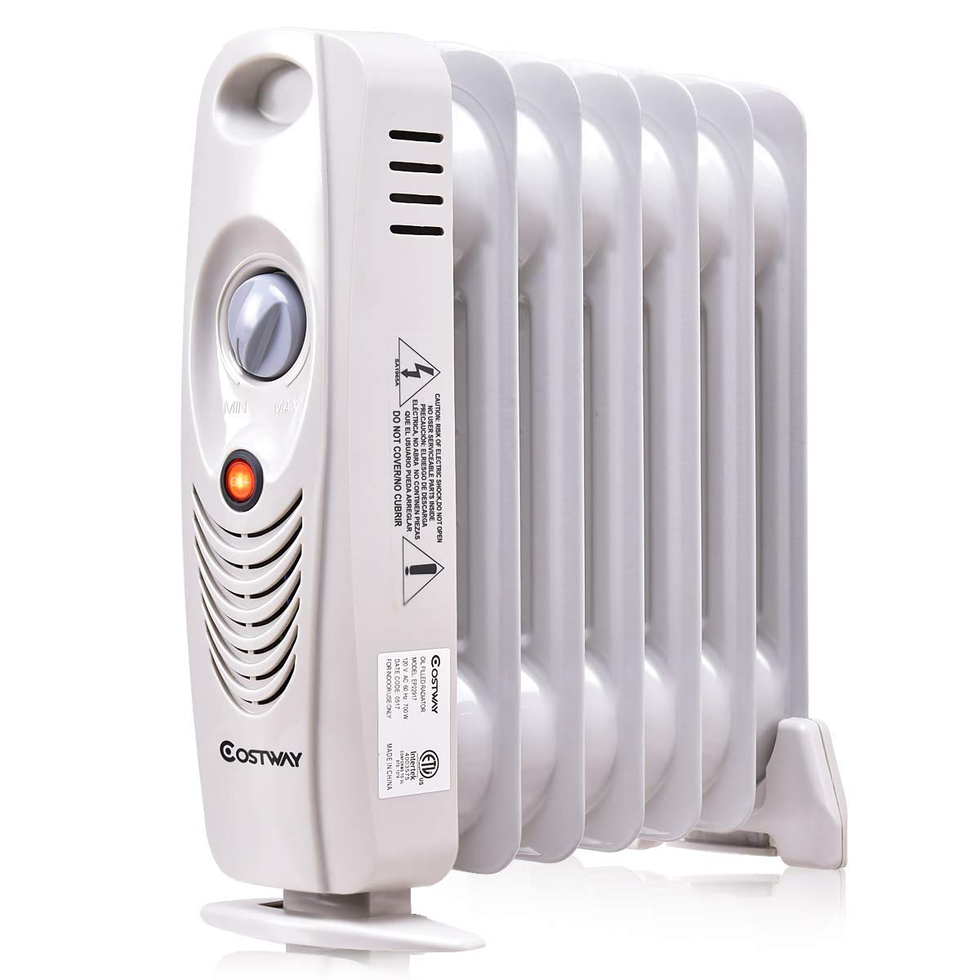
HEATING SYSTEM
Heating System – car or house
Desired temperature is given as input by user
Sensors measure current environment temperature as input
If currentTemp < desiredTemp: turn on heater
Is this system more or less energy efficient than a manual heater on/off button?

Slide 9
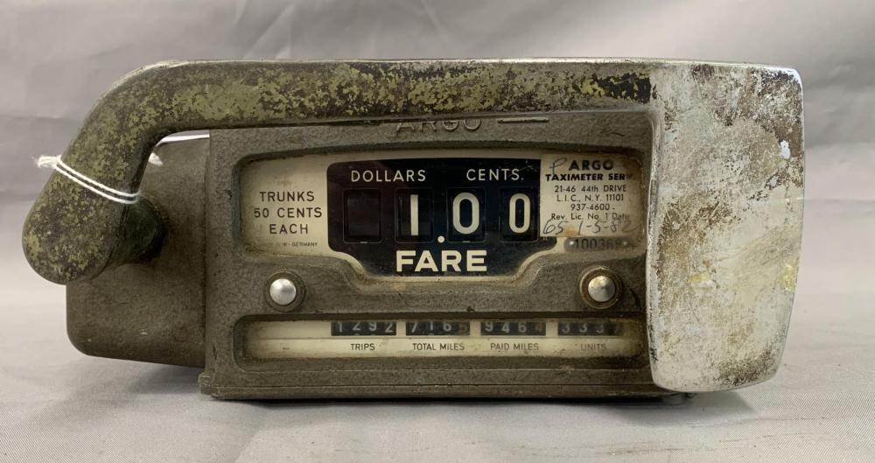
TAXI METERS
Taxi meters – old devices that would tick up every time one mile was driven
What happens nowadays instead? (assuming you don’t just Uber)

Slide 10
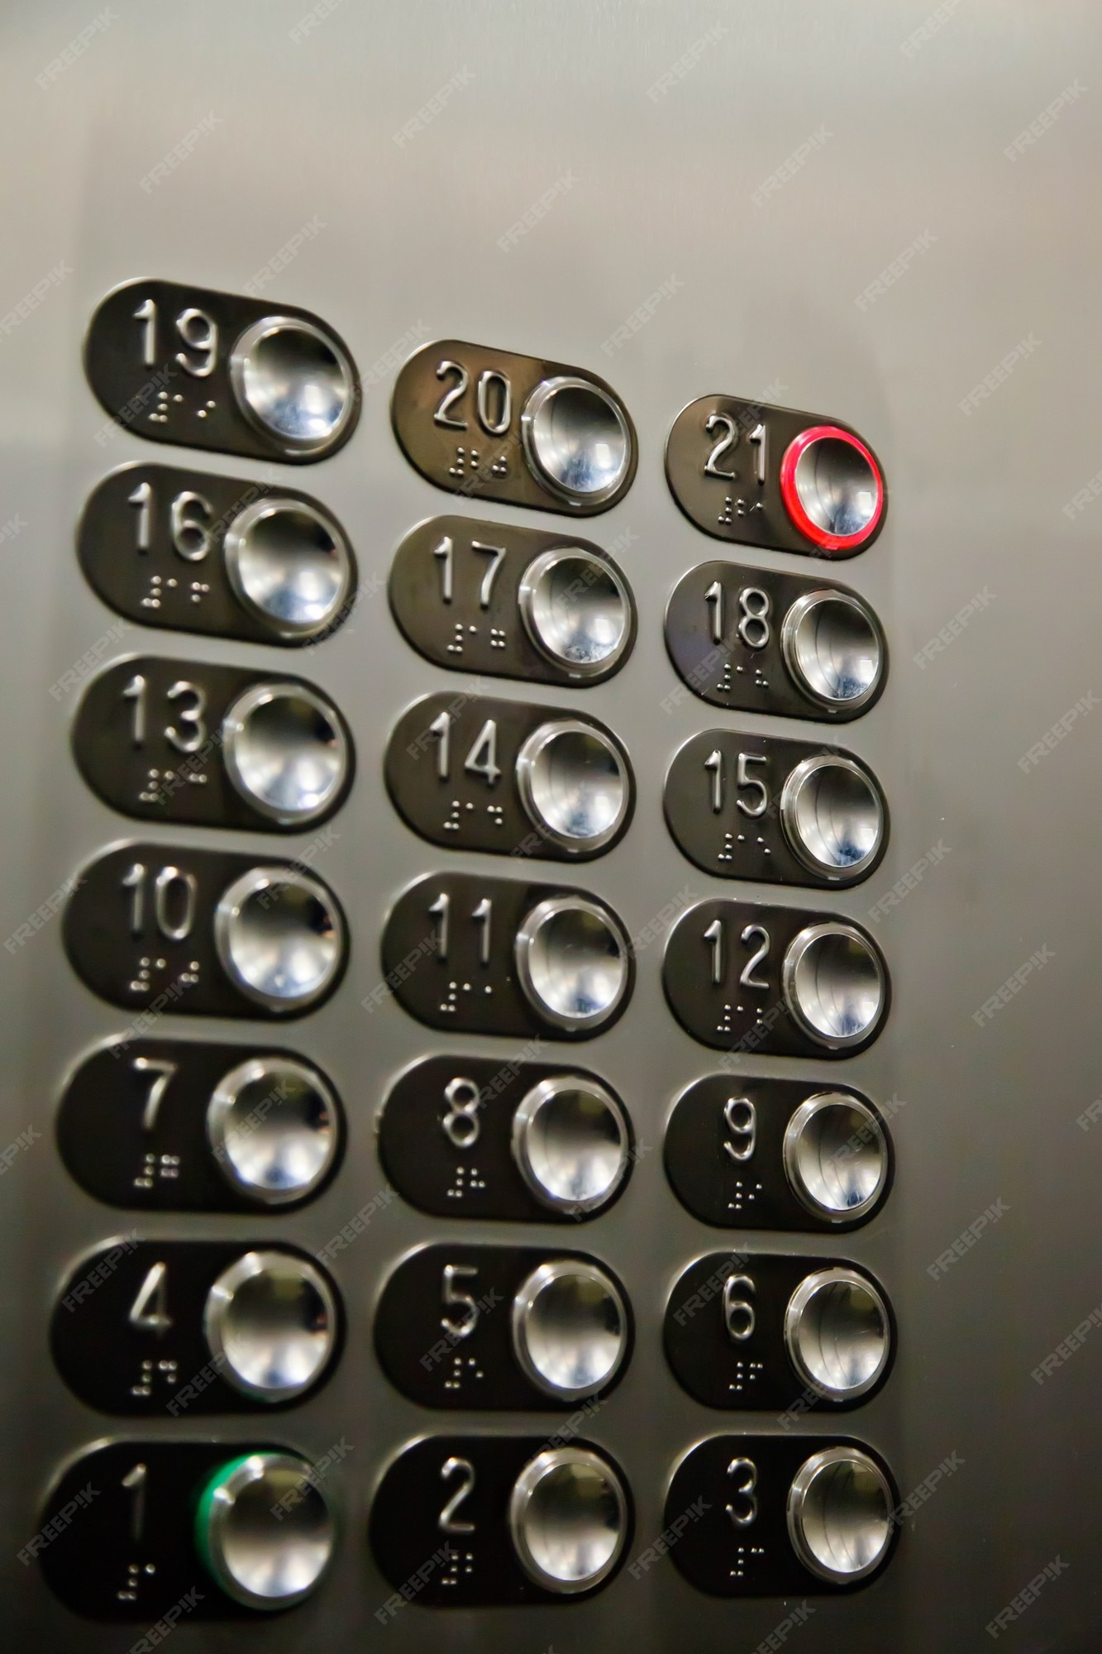
ELEVATORS
Elevators – you know what an elevator is
These, of course, if unreliable can be deadly
Modern elevators use a number of sensors and input buttons
System reads desired destination from users
System will then sense current weight
Determine if it should pick up more passengers
Motion sensors are used to stop the door from closing on people

Slide 11
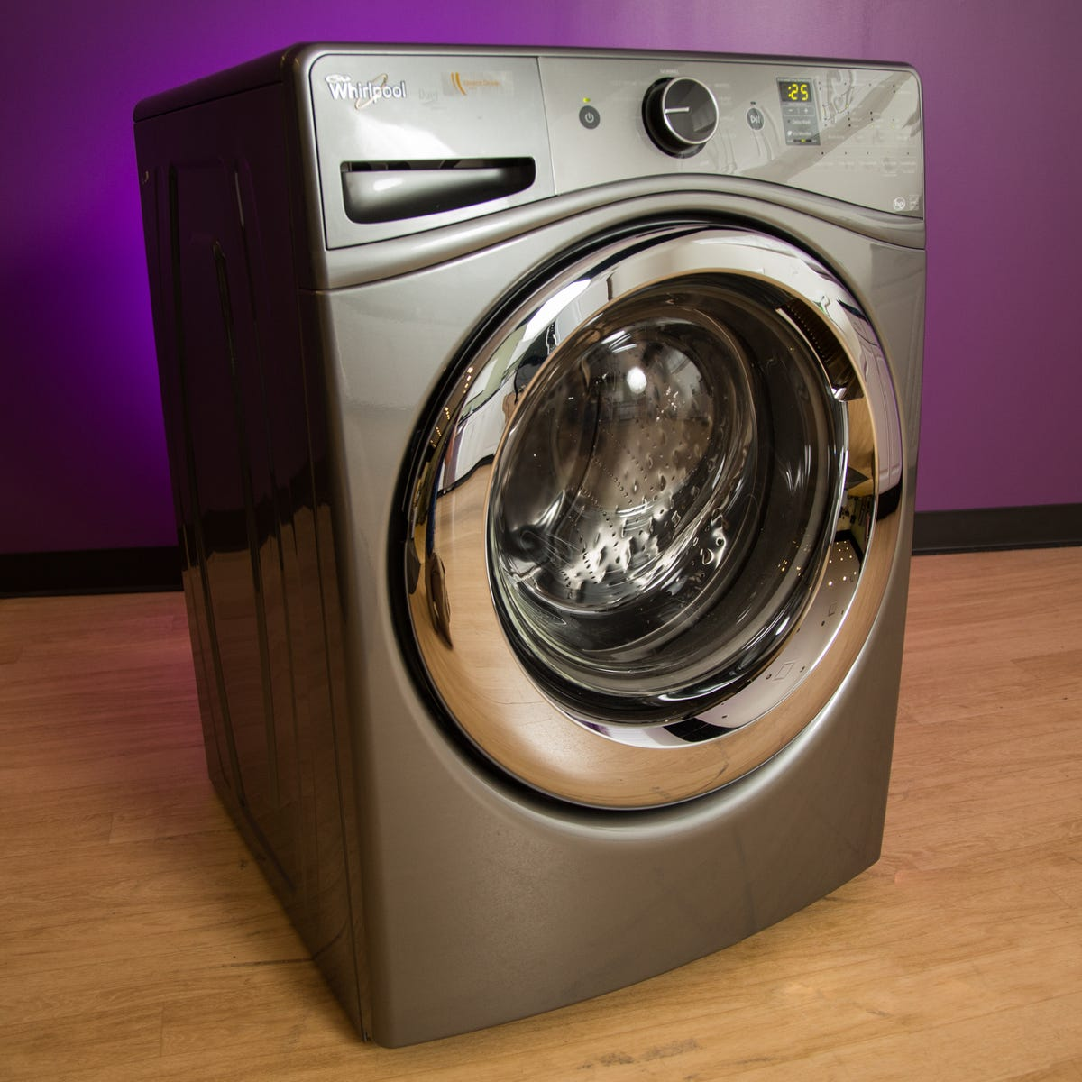
WASHING MACHINES
Washing Machines - rotate a drum washer to wash clothing
Mechanical timers added in the 20th Century
Sensors – used to determine current load size, water level, temperature
Inputs from users on knobs, buttons, screens
Sensors allow for less water and power use
Door is locked while machine is running automatically, so they are safer

Slide 12
PROCESS CONTROL
Process Control – striving to maintain the output of a variable to a specific, desired range
Open loop controllers:
A tank with a manual valve that controls heat dissipated
No feedback at any point
Closed loop controllers:
Temperature is detected automatically using sensors
Valve is pulled based on input from this

Slide 13
PROCESS CONTROL
Comparing open vs. closed loops:
Which is more prone to error?
Which is simpler to work with?
Which is cheaper?

Slide 14
DEVICE DRIVERS
Recall from our hardware unit:
What is a device driver?

Slide 15
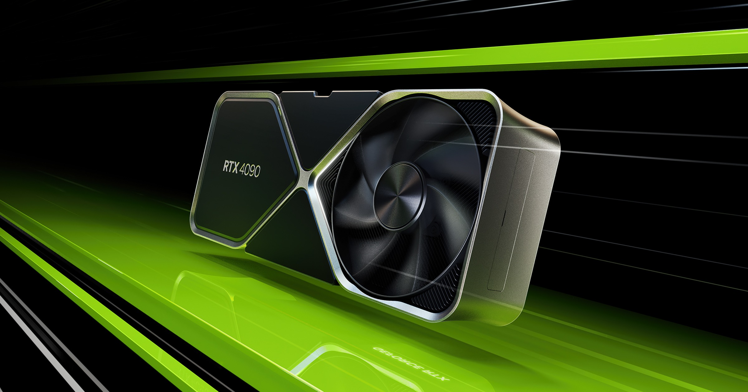
DEVICE DRIVERS
Device Drivers – computer programs used to control a device
Keyboards, printers, graphics cards
Drivers allow operating systems to access devices via abstraction
Inputs come from the CPU and outputs go back to the CPU from these various devices

Slide 16
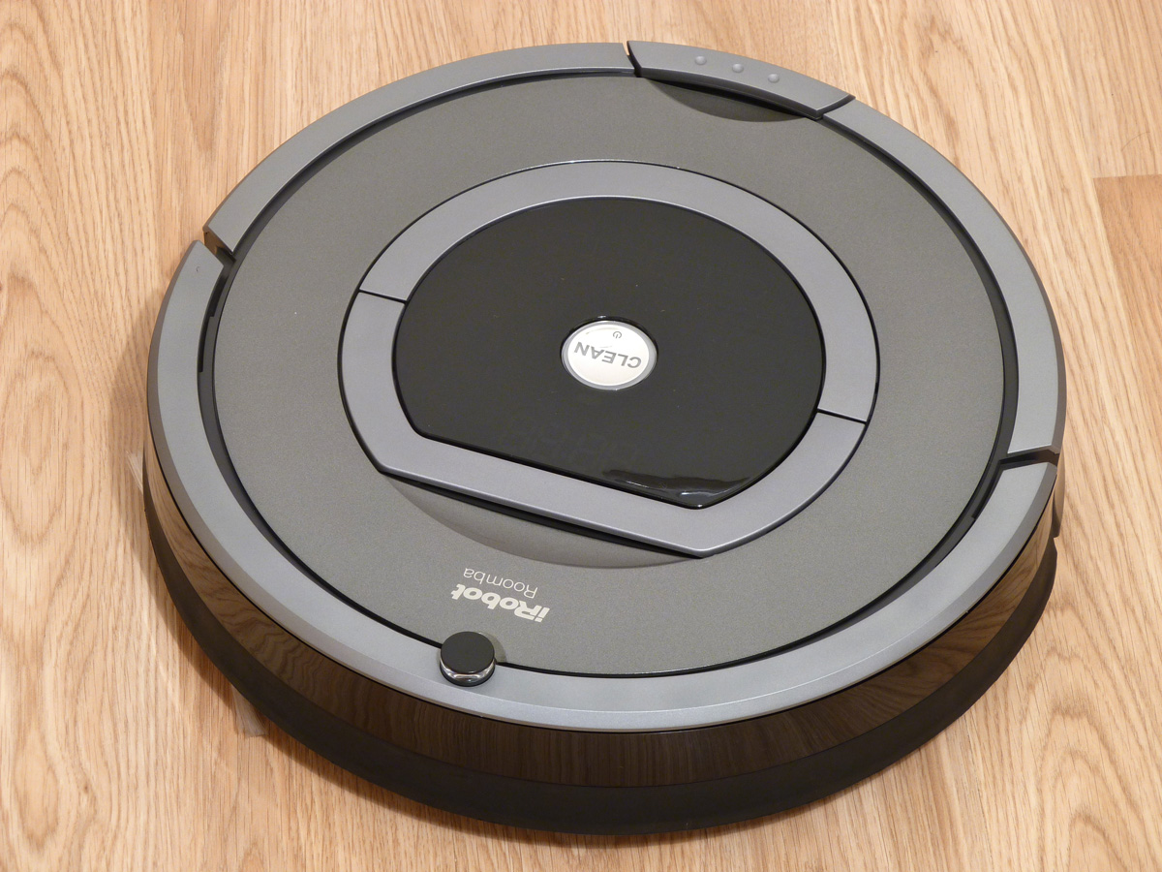
DOMESTIC ROBOTS
Domestic robots, such as automatic vacuum, pool, gutter cleaners
Roombas, for example, use sensors to create a map that allows them to navigate
They can create landmarks using cameras to know their current position as well as previous positions
Multiple subsystems – mapping, movement

Slide 17
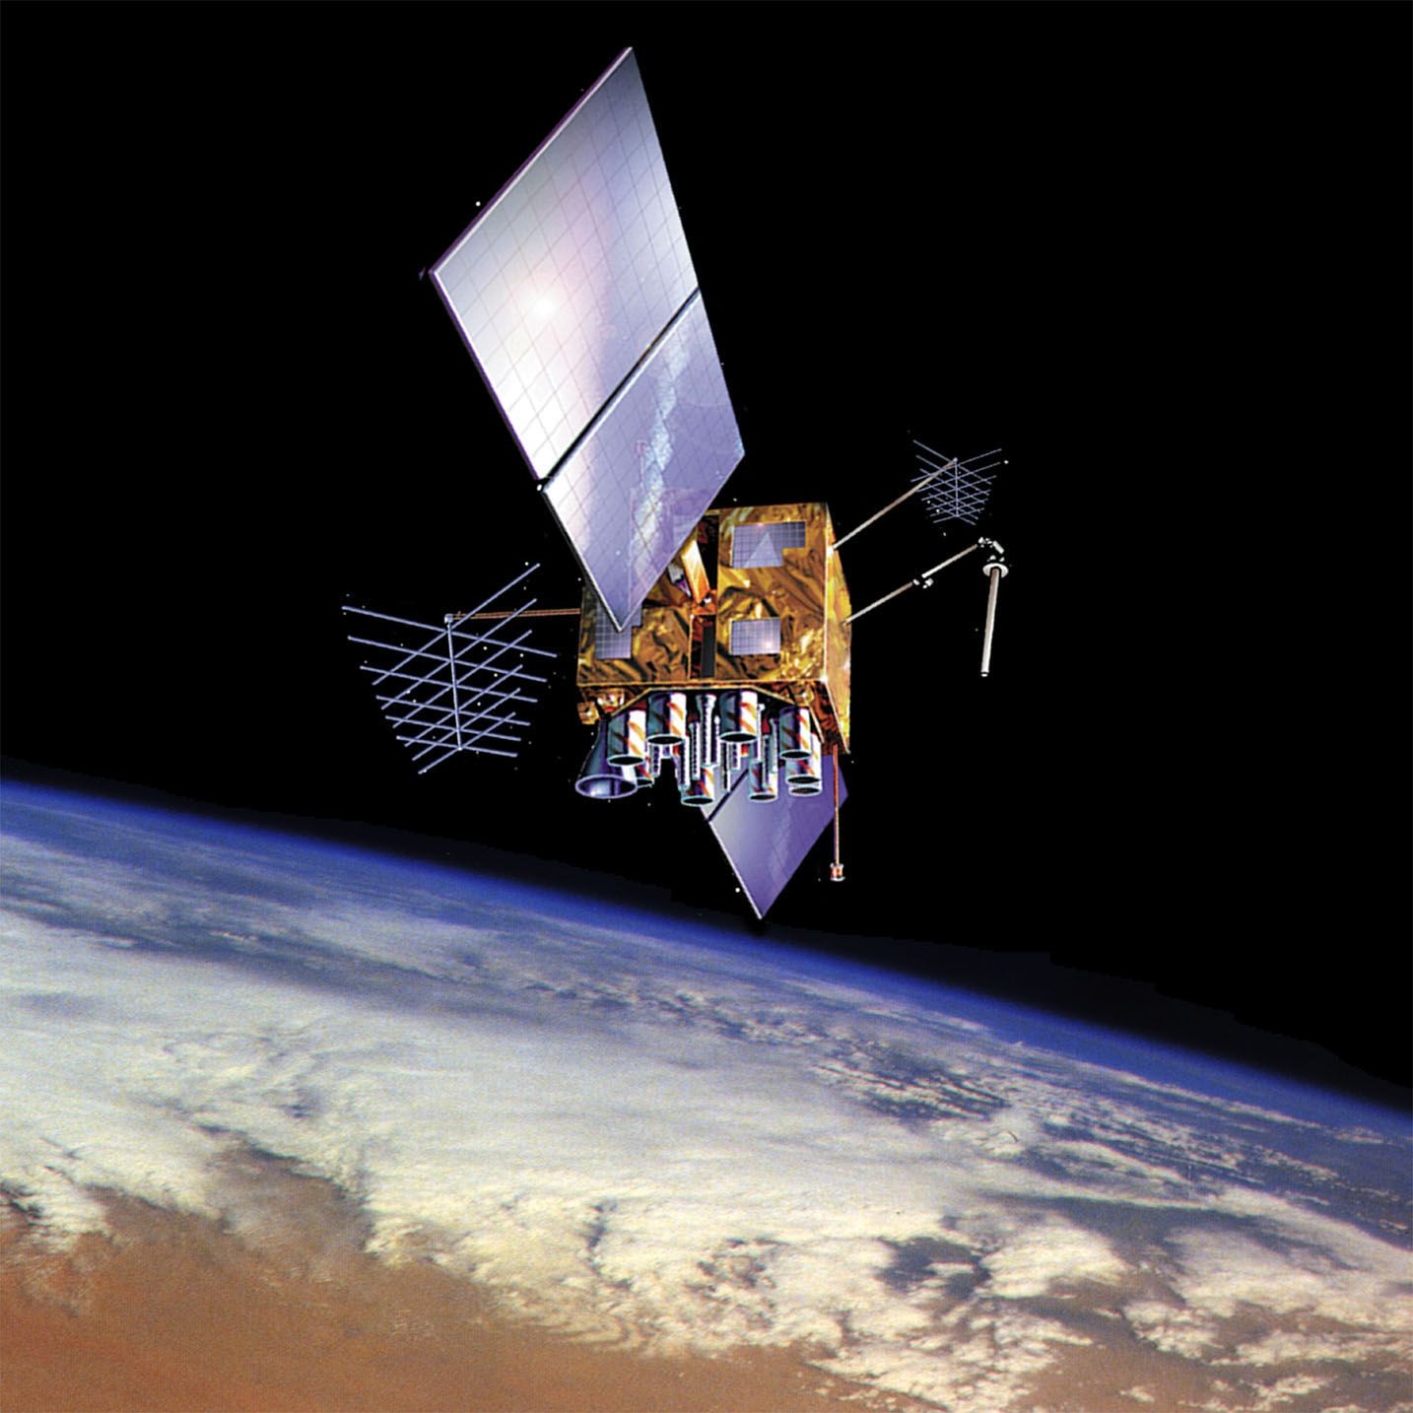
GPS SYSTEMS
GPS Systems – a large, complex system including both hardware and software elements
Requires constant maintenance and upkeep
Rougly 30 satellites around earth (plus failsafes).
GPS recievers include a sensor that locate 4 or more of the satellites to calculate their exact position
We can also provide input such as desired destination

Slide 18
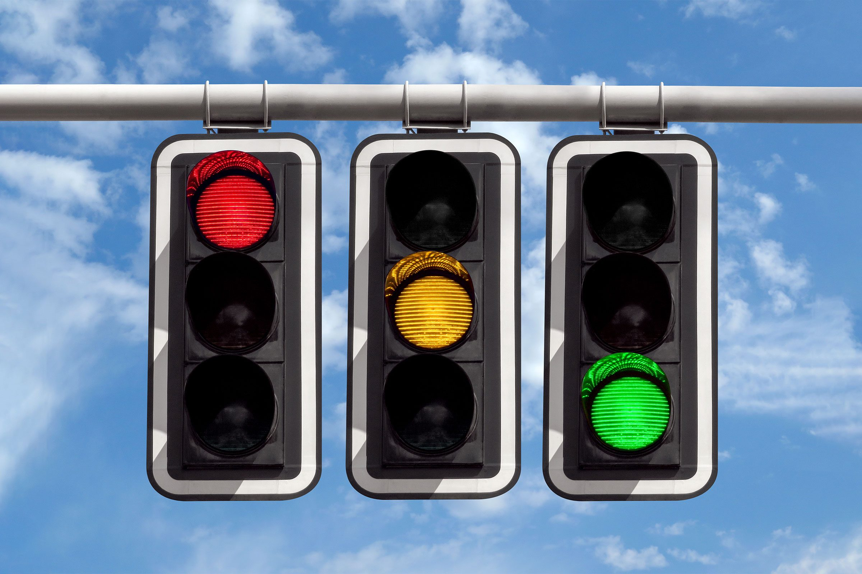
TRAFFIC LIGHTS
Traffic lights – manage traffic, prevent accidents, allow pedestrians to cross
Fixed time – some systems do not receive feedback from the environment
Configured to change color after a given period of time
Dynamic control – take input for number of cars passing by
Sensors can be mounted above the lights
Sensors can be weight based in the road

Slide 19
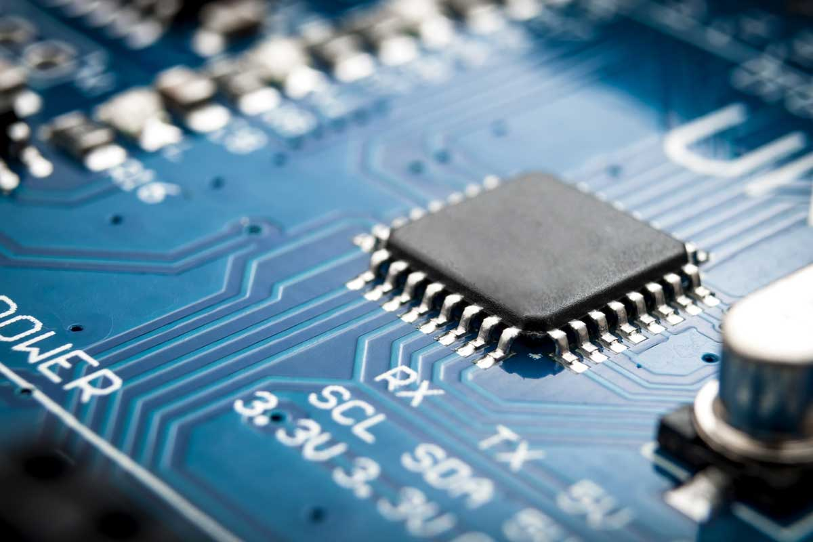
MICROPROCESSORS
Most modern control systems use mircoprocessors
Read sensor input, process it according to an algorithm, and perform corresponding actions

Slide 20
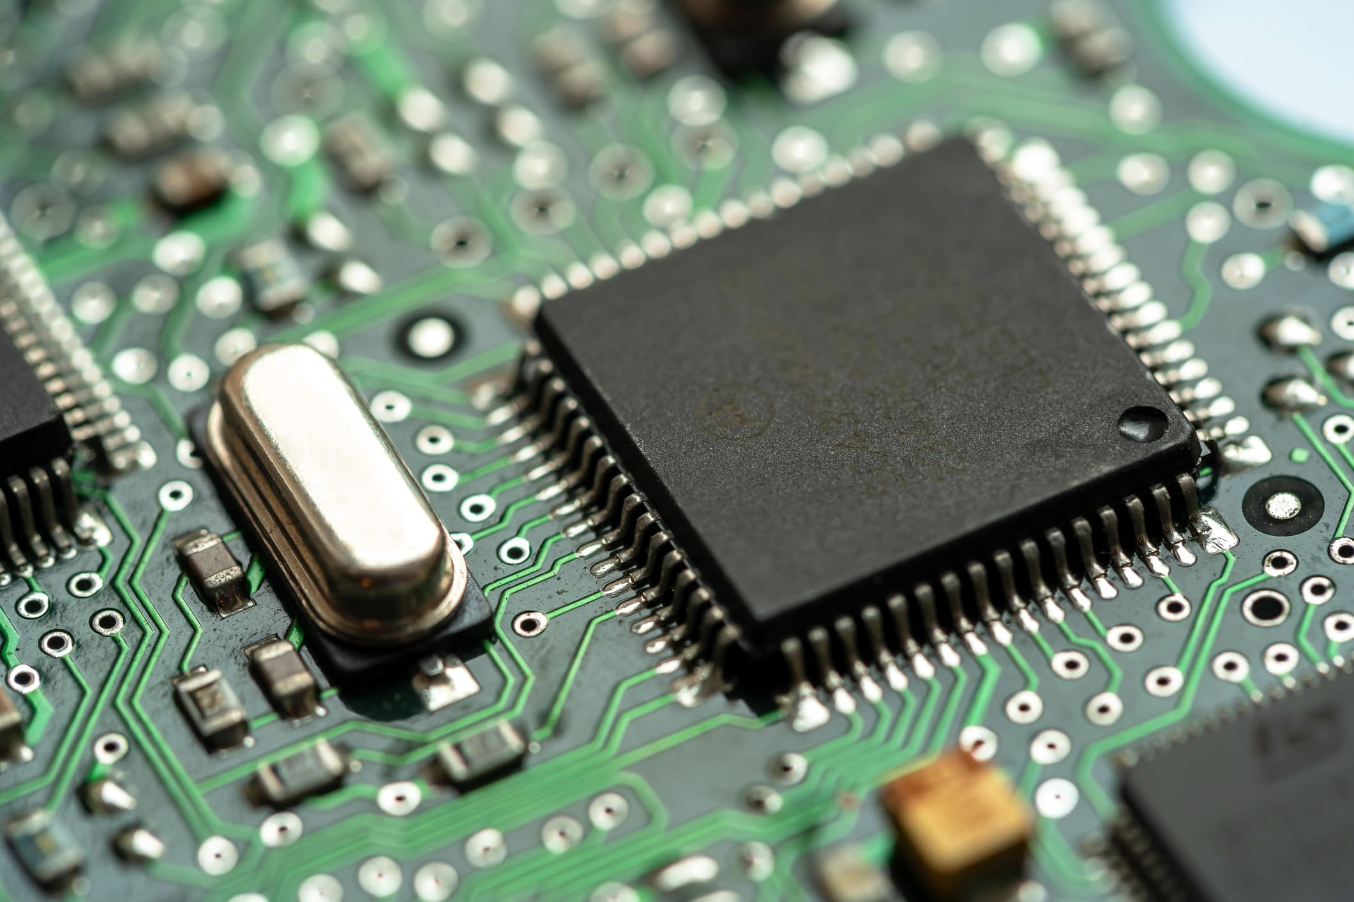
MICROPROCESSORS
Types of microprocessors:
General purpose: can run a wide variety of programs. Desktop CPUs are examples of this
Embedded controller/microcontroller: standalone chips that include CPU, RAM, ROM
Designed to do precise, specific, single tasks, do not need to be used variably
Graphics Processing Unit (GPU): Allows for faster handling of graphics and related mathematics (also AI & Crypto)

Slide 21
SENSORS
Sensors – used by microprocessors to receive input
Quality of a sensor is based on the following:
Accuracy – measurement of the physical quantity is accurate to the digital signal
Range – the range of physical inputs it can detect
Example: temp sensor can only read from -30 to 60 Celcius
Resolution – smallest increment of change that a sensor can detect
Temp sensor being able to detect difference between 12.1 and 12.2 degrees, instead of just 11 and 12 degrees

Slide 22
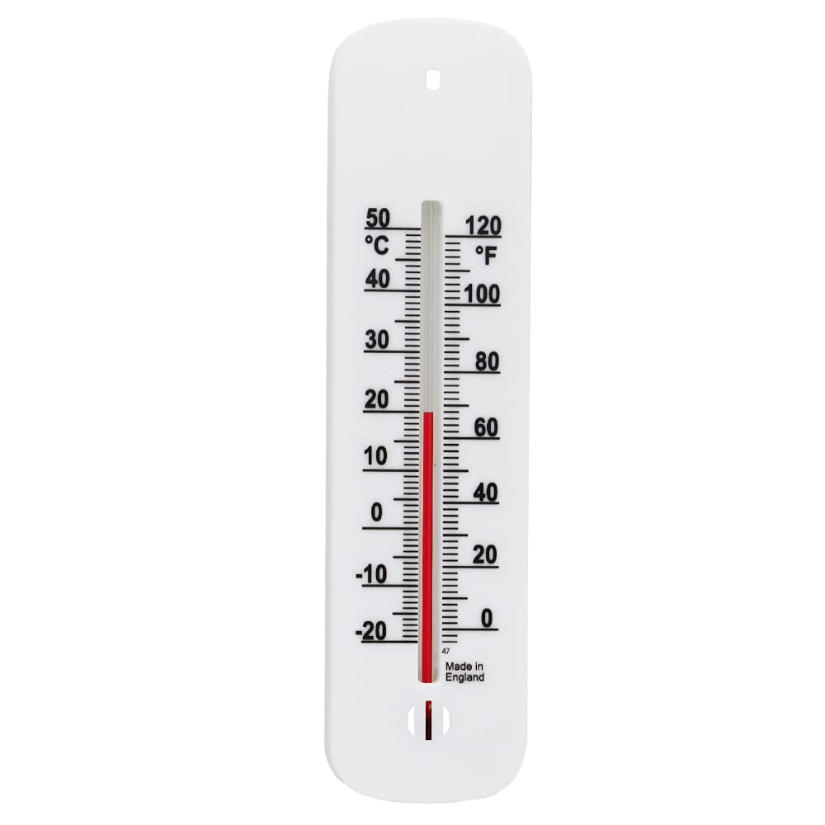
SENSORS
Sensors should also not detect anything that is NOT their listed input
If a temperature sensor is influenced by humidity or wind, it isn’t a very effective temperature sensor

Slide 23
ACTIVITY
Brainstorm 2 systems that you interact with regularly, determine the inputs, process, output, and any sensors that it may use

Slide 24
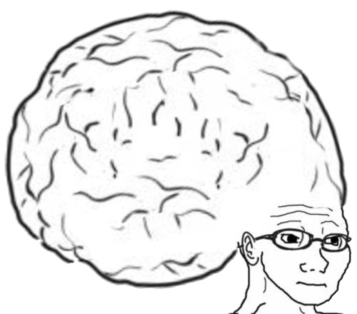
VOCAB TO REMEMBER
Control Systems
Microprocessor
Sensors
Input
Output

